Slide 1
Is Suicide the Answer
(Suicide, 2016)
Candidate: 3207

Slide 2
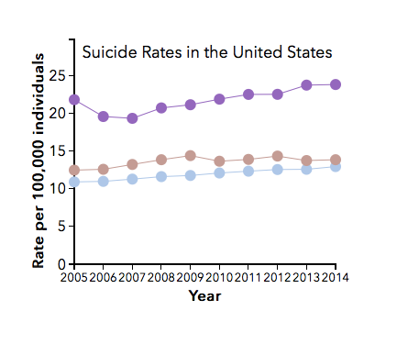
Local Problem
Grey — National Average
Tan — Florida Average
Purple — Montana Average
http://afsp.org/about-suicide/suicide-statistics/

Slide 3
Ethical Reasoning

Slide 4
Introduction
Is Suicide The Answer?
No
Yes
Religion
Resents It
Life Gets Worse
Society
Frowns
Upon It
(Suicide, 2016)

Slide 5
Religion Resents It

Slide 6
(Eccesiastes, 2016)
(Quran, 2016)
(Quran 2: 195, 2016)

Slide 7
Society Resents It

Slide 8
(Suicide Prevention, 2016)
(Papyrus, 2016)
(World Suicide Prevention, 2016)

Slide 9
Life Gets Worse

Slide 10
(Life Sucks Then You Die, 2016)
(APA, 2016)
(Life Sucks Then You Die, 2016)

Slide 11
(Reflection, 2016)
(Refection, 2016)
(Reflection, 2016)

Slide 13
References
About Us (2016). Retrieved April 21, 2016, from https://www.papyrus-uk.org/about/vision-mission-values
Bleach, M. (2016). About Us. Retrieved April 21, 2016, from http://suicidepreventionaust.org/about/
“Causes of Stress.” Stress in America 42.1 (2011): 60-61 APA. American Psychological Association, Jan. 2011. Web. 8 May 2016. http://www.apa.org/monitor/2011/01/stressed-america.apsx
English Bible Online. (2010). Retrieved April 21, 2016, from http://www.o-bible.com
The Quranic Arabic Corpus - Translation (2011). Retrieved April 21, 2016 from, http://www.corpus.quran.com/translation.jsp?chapter=2
Park, Ju-Min, and David Brunnstrom. “ North Korea Test-fires Two Missiles, Both Fail: U.S. Reuters. Thomson Reuters, 28 April, 2016. Web. 8 May 2016. http://www.reuters.com/article/us-northkorea-missle-idUSKCN0XP0R2

